Slide 1
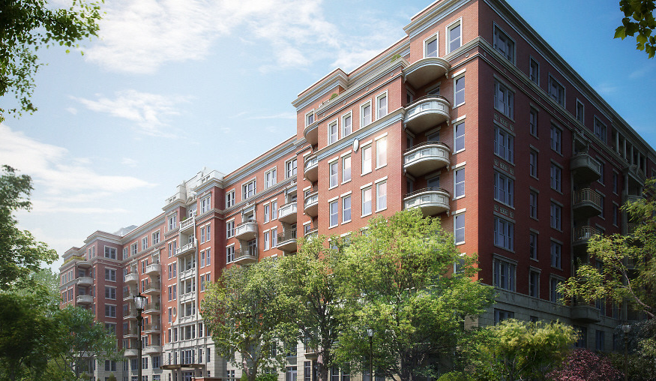
Wardman West Residential
Penn State AE Senior Thesis Project
Kevin Kroener │Construction Option
Faculty Advisor │Ray Sowers

Slide 2
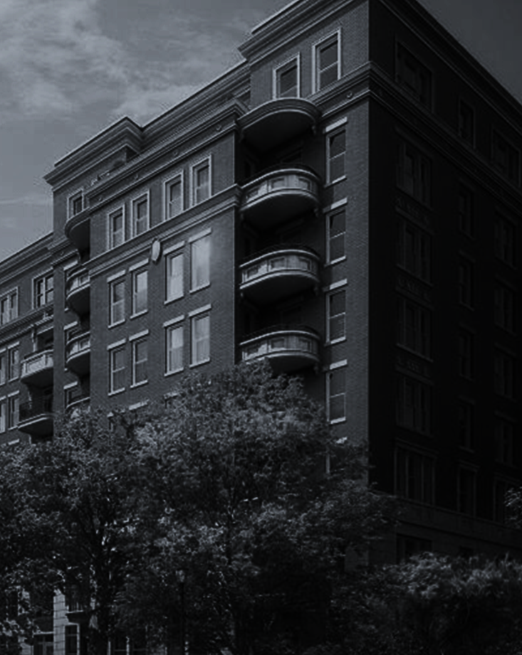

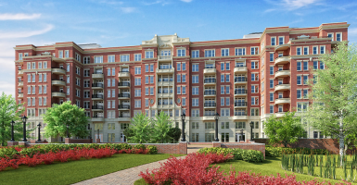
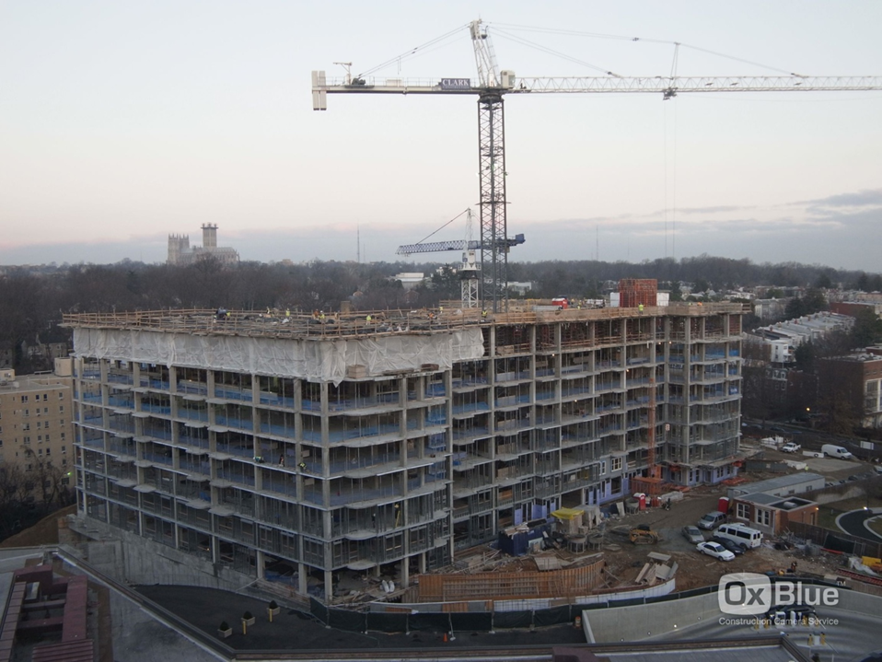




Introduction
AE Senior Thesis Project
Kevin Kroener │Construction Option
Wardman West Residential
Woodley Park, NW Washington, DC
Introduction
  Project Background
  Analysis Overview
Depth 1: APC Panel Prefabrication
Depth 2: SIPS
Depth 3: Safety Evaluation
Conclusions & Recommendations
Acknowledgements
Project Background
    Location │ Woodley Park, NW Washington, DC
    Building Type │Midrise Luxury Apartment Building
    Project Size│321,000 GSF (132,500 SF Below Grade)
    Number of Stories│8 Above - Grade / 2 Below - Grade
    Contract Value│$88 million
    Contract Type │Negotiated GMP
    Dates of Construction │June 16, 2011 – March 14, 2014
    GC │Clark Construction Group, LLC
    Owner/Developer │The JBG Companies
    Architect │Cooper Carry
Courtesy of Clark Construction

Slide 3
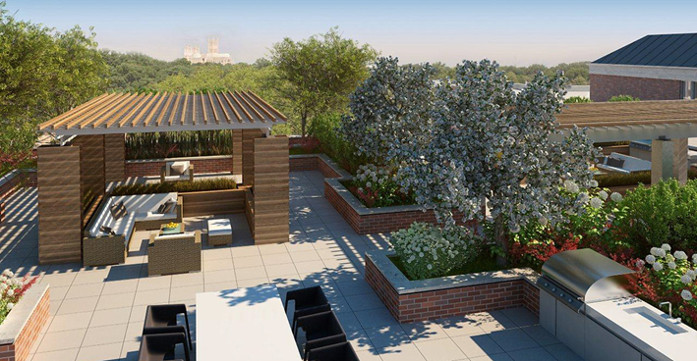
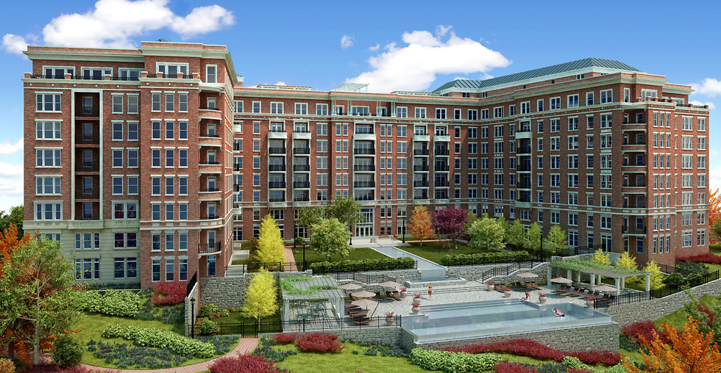

Introduction
AE Senior Thesis Project
Kevin Kroener │Construction Option
Wardman West Residential
Woodley Park, NW Washington, DC
Introduction
  Project Background
  Analysis Overview
Depth 1: APC Panel Prefabrication
Depth 2: SIPS
Depth 3: Safety Evaluation
Conclusions & Recommendations
Acknowledgements
Thesis Focus
Slow Exterior Brick Masonry Work
Courtesy of Clark Construction
Courtesy of Clark Construction

Slide 4
Introduction
AE Senior Thesis Project
Kevin Kroener │Construction Option
Wardman West Residential
Woodley Park, NW Washington, DC
Introduction
  Project Background
  Analysis Overview
Depth 1: APC Panel Prefabrication
Depth 2: SIPS
Depth 3: Safety Evaluation
Conclusions & Recommendations
Acknowledgements
Thesis Focus
Slow Exterior Brick Masonry Work
Analysis Overview
  Analysis 1: Architectural Precast Concrete Wall Panels
  Thermal Performance Study
  Structural Feasibility & Redesign Study
  Analysis 2: SIPS (Short Interval Production Schedule)
  Analysis 3: Safety Evaluation
  Analysis 4: General Contractor Implementation Plan for APC Wall Panels
Courtesy of Clark Construction
Courtesy of Clark Construction

Slide 5
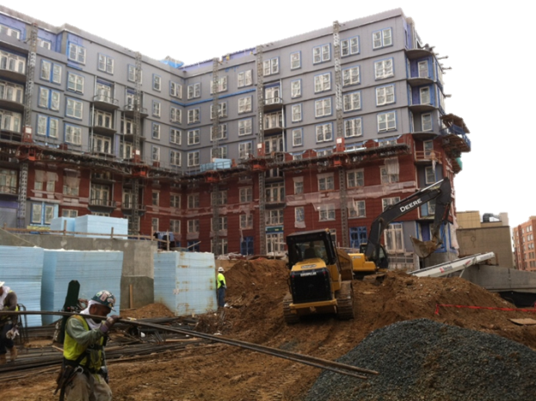
APC Wall Panel Prefabrication
AE Senior Thesis Project
Kevin Kroener │Construction Option
Wardman West Residential
Woodley Park, NW Washington, DC
Introduction
Depth 1: APC Panel Prefabrication
  Overview & Existing Wall System
  Product Selection
  Transportation & Logistics
  Cost Savings & Schedule Acceleration
  Structural Feasibility Study
Depth 2: SIPS
Depth 3: Safety Evaluation
Conclusions & Recommendations
Acknowledgements
Problem:
  Lagging Exterior Brick Masonry Work
Proposed Solution:
  Substitute Architectural Precast Concrete Wall Panels for Brick Veneer Wall

Slide 6
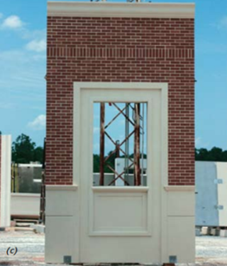
APC Wall Panel Prefabrication
AE Senior Thesis Project
Kevin Kroener │Construction Option
Wardman West Residential
Woodley Park, NW Washington, DC
Introduction
Depth 1: APC Panel Prefabrication
  Overview & Existing Wall System
  Product Selection
  Transportation & Logistics
  Cost Savings & Schedule Acceleration
  Structural Feasibility Study
Depth 2: SIPS
Depth 3: Safety Evaluation
Conclusions & Recommendations
Acknowledgements
Overview
Problem:
  Lagging Exterior Brick Masonry Work
Proposed Solution:
  Substitute Architectural Precast Concrete Wall Panels for Brick Veneer Wall
Benefits to Architectural Precast Concrete Wall Panels
Aesthetic Flexibility
Product Quality
Energy Performance
Cost Savings
Schedule Acceleration
Courtesy of PCI

Slide 7
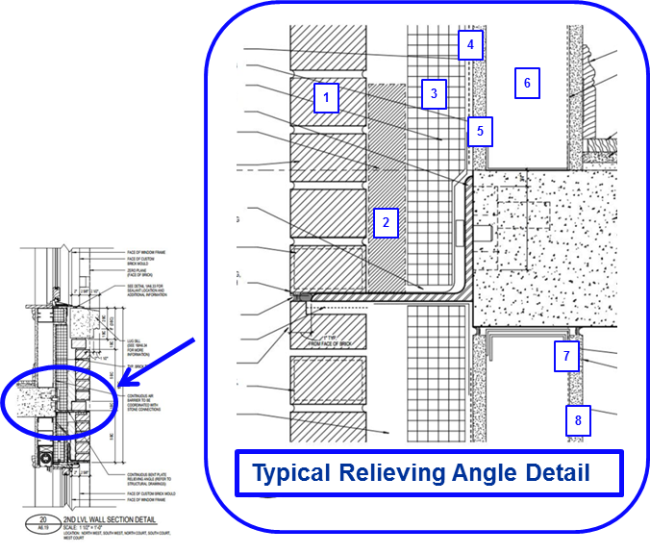
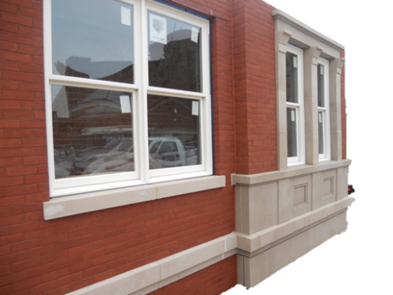
APC Wall Panel Prefabrication
AE Senior Thesis Project
Kevin Kroener │Construction Option
Wardman West Residential
Woodley Park, NW Washington, DC
Introduction
Depth 1: APC Panel Prefabrication
  Overview & Existing Wall System
  Product Selection
  Transportation & Logistics
  Cost Savings & Schedule Acceleration
  Structural Feasibility Study
Depth 2: SIPS
Depth 3: Safety Evaluation
Conclusions & Recommendations
Acknowledgements
Overview
Existing Wall System
Problem:
  Lagging Exterior Brick Masonry Work
Proposed Solution:
  Substitute Architectural Precast Concrete Wall Panels for Brick Veneer Wall
Material | Thickness (inches)
1. Standard Brick (Glen Gery 52 DD) | 4
2. Air Cavity | 2
3. Rigid Insulation (Dow EPS) | 3
4. Permeable Air Barrier | --
5. Exterior Sheathing | 5/8
6. Cold-Formed 18 Ga. Metal Stud (16’’ OC) | 4
7. Polyethylene Vapor Barrier | --
8. 5/8’’ Gypsum Wall Board | 5/8
Benefits to Architectural Precast Concrete Wall Panels
Aesthetic Flexibility
Product Quality
Energy Performance
Cost Savings
Schedule Acceleration
Courtesy of PCI
Courtesy of Clark Construction

Slide 8
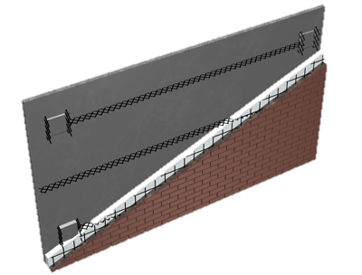
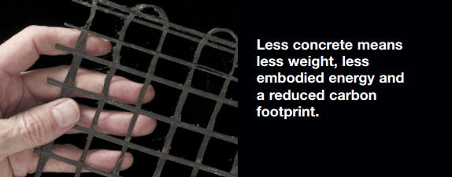
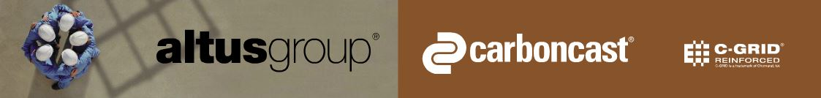
APC Wall Panel Prefabrication
AE Senior Thesis Project
Kevin Kroener │Construction Option
Wardman West Residential
Woodley Park, NW Washington, DC
Introduction
Depth 1: APC Panel Prefabrication
  Overview & Existing Wall System
  Product Selection
  Transportation & Logistics
  Cost Savings & Schedule Acceleration
  Structural Feasibility Study
Depth 2: SIPS
Depth 3: Safety Evaluation
Conclusions & Recommendations
Acknowledgements
Product Selection
Selection:
CarbonCast Insulated Architectural Cladding
Product Advantages:
Reduced load on building structure
Lower transportation cost
Smaller cranes can be used to pick and erect CarbonCast panels
Lower carbon footprint
Aesthetic Versatility
Meets ASHRAE requirement for continuous insulation
C-GRID Carbon Fiber Grid:
Shear connector between concrete wythes
Minimum wythe thickness of 1 ¾’’
Up to 40% lighter
Courtesy of AltusGroup

Slide 9
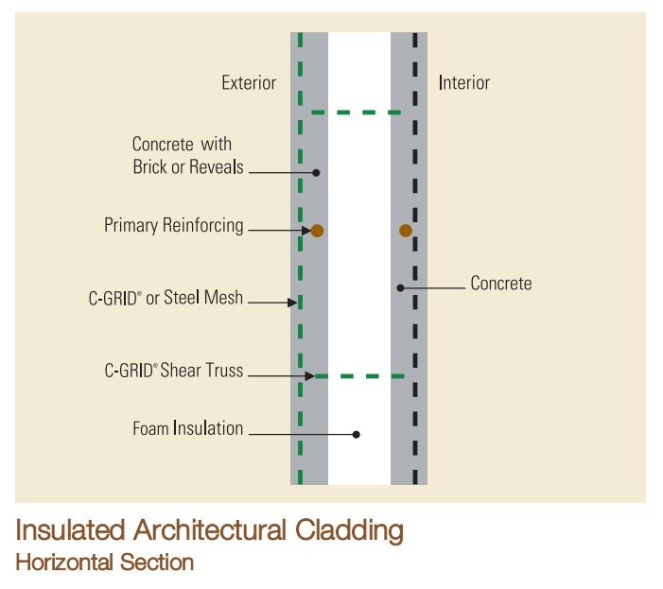
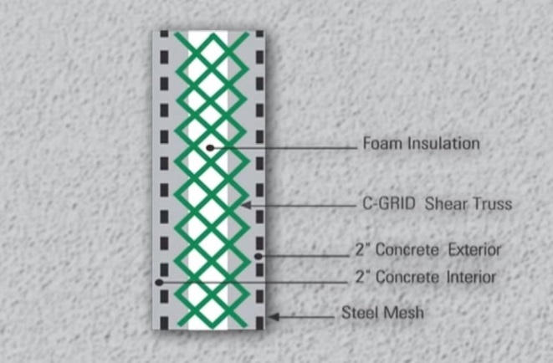
APC Wall Panel Prefabrication
AE Senior Thesis Project
Kevin Kroener │Construction Option
Wardman West Residential
Woodley Park, NW Washington, DC
Introduction
Depth 1: APC Panel Prefabrication
  Overview & Existing Wall System
  Product Selection
  Transportation & Logistics
  Cost Savings & Schedule Acceleration
  Structural Feasibility Study
Depth 2: SIPS
Depth 3: Safety Evaluation
Conclusions & Recommendations
Acknowledgements
Product Selection
Selection:
CarbonCast Insulated Architectural Cladding
Product Advantages:
Reduced load on building structure
Lower transportation cost
Smaller cranes can be used to pick and erect CarbonCast panels
Lower carbon footprint
Aesthetic Versatility
Meets ASHRAE requirement for continuous insulation
EPS, XPS or Poly-Iso foam Rigid Insulation
C-GRID Carbon Fiber Grid:
Shear connector between concrete wythes
Minimum wythe thickness of 1 ¾’’
Up to 40% lighter
Courtesy of AltusGroup
Courtesy of AltusGroup
Courtesy of AltusGroup

Slide 10
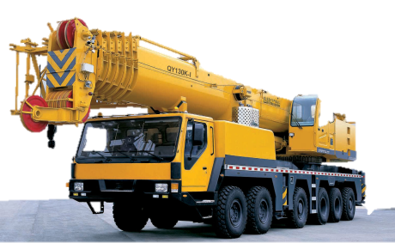
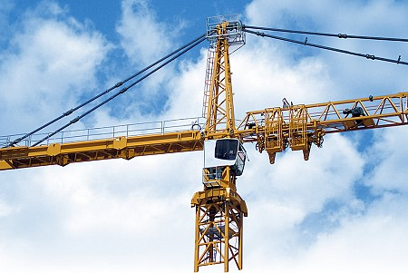
APC Wall Panel Prefabrication
AE Senior Thesis Project
Kevin Kroener │Construction Option
Wardman West Residential
Woodley Park, NW Washington, DC
Introduction
Depth 1: APC Panel Prefabrication
  Overview & Existing Wall System
  Product Selection
  Transportation & Logistics
  Cost Savings & Schedule Acceleration
  Structural Feasibility Study
Depth 2: SIPS
Depth 3: Safety Evaluation
Conclusions & Recommendations
Acknowledgements
Crane Use
Mobile Crane
Precast Subcontractor
20 ton Tower Crane
Clark Concrete
Jib Length shorten from 213’ to 180’
Capacity increased from 11,680 lb. to 17,200 lb.

Slide 11
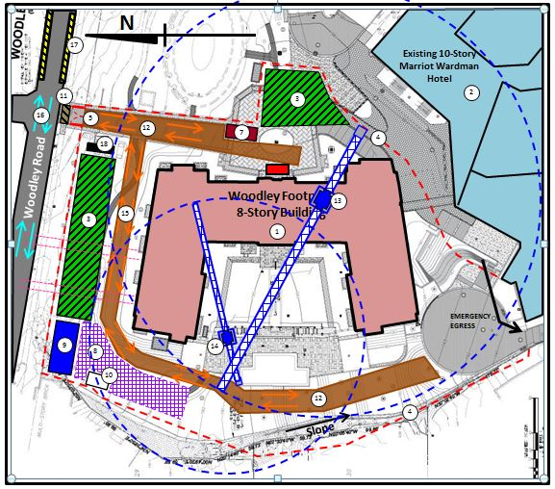
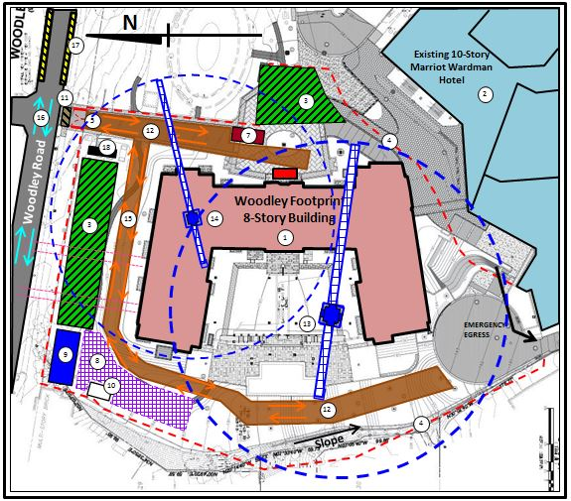
APC Wall Panel Prefabrication
AE Senior Thesis Project
Kevin Kroener │Construction Option
Wardman West Residential
Woodley Park, NW Washington, DC
Introduction
Depth 1: APC Panel Prefabrication
  Overview & Existing Wall System
  Product Selection
  Transportation & Logistics
  Cost Savings & Schedule Acceleration
  Structural Feasibility Study
Depth 2: SIPS
Depth 3: Safety Evaluation
Conclusions & Recommendations
Acknowledgements
Crane Use
Tower Crane Relocation
Mobile Crane
Precast Subcontractor
20 ton Tower Crane
Clark Concrete
Jib Length shorten from 213’ to 180’
Capacity increased from 11,680 lb. to 17,200 lb.

Slide 12
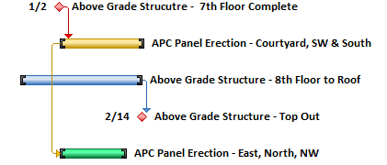
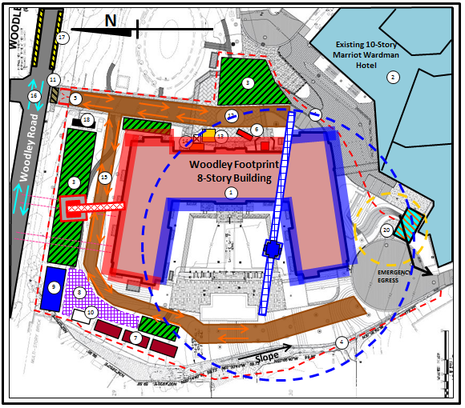
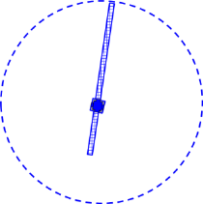

APC Wall Panel Prefabrication
AE Senior Thesis Project
Kevin Kroener │Construction Option
Wardman West Residential
Woodley Park, NW Washington, DC
Introduction
Depth 1: APC Panel Prefabrication
  Overview & Existing Wall System
  Product Selection
  Transportation & Logistics
  Cost Savings & Schedule Acceleration
  Structural Feasibility Study
Depth 2: SIPS
Depth 3: Safety Evaluation
Conclusions & Recommendations
Acknowledgements
Crane Use
Tower Crane Relocation
Workflow Sequence
Mobile Crane
Precast Subcontractor
20 ton Tower Crane
Clark Concrete
Jib Length shorten from 213’ to 180’
Capacity increased from 11,680 lb. to 17,200 lb.
Mobile Crane
Tower Crane
Elevations
North
East
Elevations
South
Courtyard

Slide 13
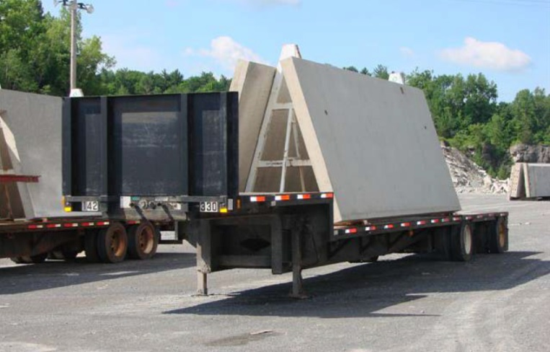
APC Wall Panel Prefabrication
AE Senior Thesis Project
Kevin Kroener │Construction Option
Wardman West Residential
Woodley Park, NW Washington, DC
Introduction
Depth 1: APC Panel Prefabrication
  Overview & Existing Wall System
  Product Selection
  Transportation & Logistics
  Cost Savings & Schedule Acceleration
  Structural Feasibility Study
Depth 2: SIPS
Depth 3: Safety Evaluation
Conclusions & Recommendations
Acknowledgements
Transportation
Flatbed or Low-deck Trailers:
Used for precast panels < 12’ x 40’
Courtesy of Oldcastle

Slide 14
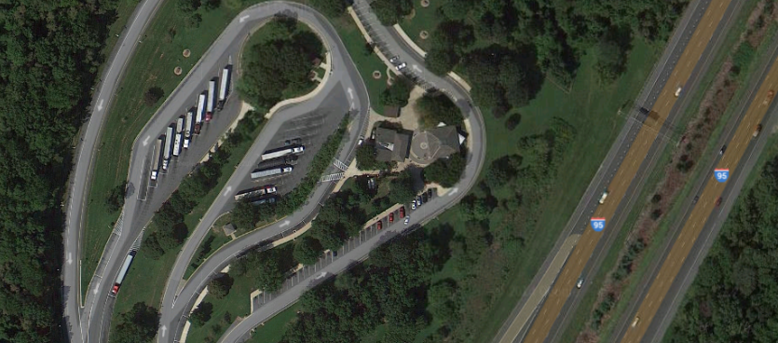
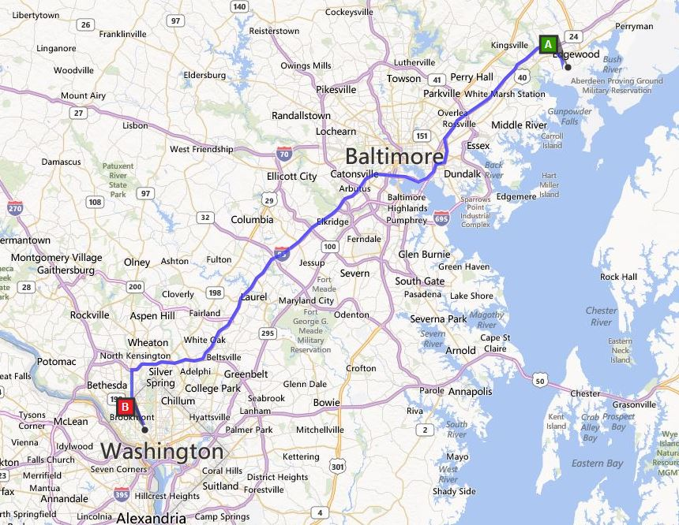

APC Wall Panel Prefabrication
AE Senior Thesis Project
Kevin Kroener │Construction Option
Wardman West Residential
Woodley Park, NW Washington, DC
Introduction
Depth 1: APC Panel Prefabrication
  Overview & Existing Wall System
  Product Selection
  Transportation & Logistics
  Cost Savings & Schedule Acceleration
  Structural Feasibility Study
Depth 2: SIPS
Depth 3: Safety Evaluation
Conclusions & Recommendations
Acknowledgements
Transportation
Delivery
Flatbed or Low-deck Trailers:
Used for precast panels < 12’ x 40’
Shipping:
Oldcastle Precast Building Systems
Plant Location – Edgewood, Maryland
Rest Stop Staging
I-95 Maryland Rest and Welcome Area
32 Miles from Beltway (I-495)
Courtesy of Oldcastle

Slide 15
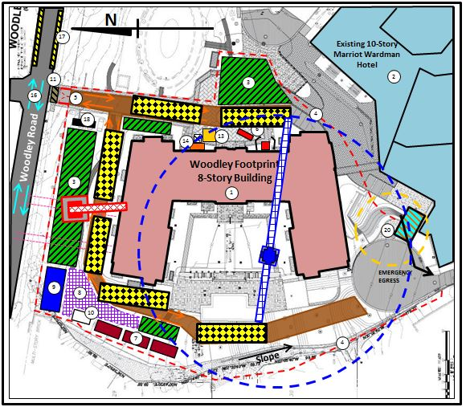

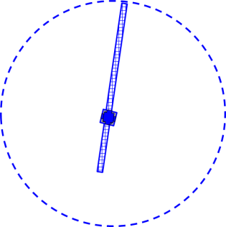
APC Wall Panel Prefabrication
AE Senior Thesis Project
Kevin Kroener │Construction Option
Wardman West Residential
Woodley Park, NW Washington, DC
Introduction
Depth 1: APC Panel Prefabrication
  Overview & Existing Wall System
  Product Selection
  Transportation & Logistics
  Cost Savings & Schedule Acceleration
  Structural Feasibility Study
Depth 2: SIPS
Depth 3: Safety Evaluation
Conclusions & Recommendations
Acknowledgements
Transportation
Delivery
Site Staging
Flatbed or Low-deck Trailers:
Used for precast panels < 12’ x 40’
Shipping:
Oldcastle Precast Building Systems
Plant Location – Edgewood, Maryland
Staging Area
Mobile Crane
Tower Crane
Courtesy of Oldcastle

Slide 16

APC Wall Panel Prefabrication
AE Senior Thesis Project
Kevin Kroener │Construction Option
Wardman West Residential
Woodley Park, NW Washington, DC
Introduction
Depth 1: APC Panel Prefabrication
  Overview & Existing Wall System
  Product Selection
  Transportation & Logistics
  Cost Savings & Schedule Acceleration
  Structural Feasibility Study
Depth 2: SIPS
Depth 3: Safety Evaluation
Conclusions & Recommendations
Acknowledgements
Cost Savings
Existing Brick Veneer Wall System
Item | Amount
Brick | $2,676,060
Backup, Sheathing and Insulation | $55,834
Metals | $292,500
Misc. | $246,375
Limestone | $843,570
Total | $4,114,339
APC Wall Panels
Item | Amount
Architectural Precast Concrete Panels (including attachment hardware) | $2,768,480
Penthouse Brick | $205,905
Metals | $292,500
Misc. | $407,355
Total | $3,468,335

Slide 17
APC Wall Panel Prefabrication
AE Senior Thesis Project
Kevin Kroener │Construction Option
Wardman West Residential
Woodley Park, NW Washington, DC
Introduction
Depth 1: APC Panel Prefabrication
  Overview & Existing Wall System
  Product Selection
  Transportation & Logistics
  Cost Savings & Schedule Acceleration
  Structural Feasibility Study
Depth 2: SIPS
Depth 3: Safety Evaluation
Conclusions & Recommendations
Acknowledgements
Cost Savings
Schedule Acceleration
Existing Brick Veneer Wall System
Activity | Start | Finish | Duration (Work Days)
APC Wall Panels | 2 Jan 2012 | 15 Feb 2013 | 32
Windows | 18 Jan 2013 | 14 Jun 2013 | 105
Stone | 6 Mar 2013 | 17 Aug 2013 | 118
Penthouse Brick | 11 Jul 2013 | 7 Aug 2013 | 20
Balcony Front Brick | 10 Jul 2013 | 10 Aug 2013 | 23
Revised Ext. Skin Total Duration | 2 Jan 2012 | 17 Aug 2013 | 163
Schedule Acceleration w/ Earlier Finish Date |  |  | 46
Item | Amount
Brick | $2,676,060
Backup, Sheathing and Insulation | $55,834
Metals | $292,500
Misc. | $246,375
Limestone | $843,570
Total | $4,114,339
Original Duration for Brick Work:
145 Days
APC Wall Panels
Accelerated Duration for APC Wall Panels:
32 Days
Item | Amount
Architectural Precast Concrete Panels (including attachment hardware) | $2,768,480
Penthouse Brick | $205,905
Metals | $292,500
Misc. | $407,355
Total | $3,468,335
Activity | Duration (Work Days)
APC Wall Panels (Raw) | 57
APC Wall Panel w/ Phasing | 32
Schedule Acceleration | 88
w/ Phasing | 113

Slide 18
APC Wall Panel Prefabrication
AE Senior Thesis Project
Kevin Kroener │Construction Option
Wardman West Residential
Woodley Park, NW Washington, DC
Introduction
Depth 1: APC Panel Prefabrication
  Overview & Existing Wall System
  Product Selection
  Transportation & Logistics
  Cost Savings & Schedule Acceleration
  Structural Feasibility Study
Depth 2: SIPS
Depth 3: Safety Evaluation
Conclusions & Recommendations
Acknowledgements
Results
Cost Savings
Schedule Acceleration
SAVINGS = $646,000
16 % Cost Compared Existing System
5 % Cost of Building Enclosure
+ 46 Days to Project
Schedule
Existing Brick Veneer Wall System
Activity | Start | Finish | Duration (Work Days)
APC Wall Panels | 2 Jan 2012 | 15 Feb 2013 | 32
Windows | 18 Jan 2013 | 14 Jun 2013 | 105
Stone | 6 Mar 2013 | 17 Aug 2013 | 118
Penthouse Brick | 11 Jul 2013 | 7 Aug 2013 | 20
Balcony Front Brick | 10 Jul 2013 | 10 Aug 2013 | 23
Revised Ext. Skin Total Duration | 2 Jan 2012 | 17 Aug 2013 | 163
Schedule Acceleration w/ Earlier Finish Date |  |  | 46
Item | Amount
Brick | $2,676,060
Backup, Sheathing and Insulation | $55,834
Metals | $292,500
Misc. | $246,375
Limestone | $843,570
Total | $4,114,339
Original Duration for Brick Work:
145 Days
APC Wall Panels
Accelerated Duration for APC Wall Panels:
32 Days
Item | Amount
Architectural Precast Concrete Panels (including attachment hardware) | $2,768,480
Penthouse Brick | $205,905
Metals | $292,500
Misc. | $407,355
Total | $3,468,335
Activity | Duration (Work Days)
APC Wall Panels (Raw) | 57
APC Wall Panel w/ Phasing | 32
Schedule Acceleration | 88
w/ Phasing | 113

Slide 19




APC Wall Panel Prefabrication
AE Senior Thesis Project
Kevin Kroener │Construction Option
Wardman West Residential
Woodley Park, NW Washington, DC
Introduction
Depth 1: APC Panel Prefabrication
  Overview & Existing Wall System
  Product Selection
  Transportation & Logistics
  Cost Savings & Schedule Acceleration
  Structural Feasibility Study
Depth 2: SIPS
Depth 3: Safety Evaluation
Conclusions & Recommendations
Acknowledgements
Wind & Seismic Loading
Code:
IBC 2006 / ASCE 7-05
Assumption:
Panel Weight (12’ x 30’ @ 40 PSF) – 14,400 lb.
Wind:
Seismic:
Windward exposure
$$P = q_{h} ×\left(+GC_{p}\right)− q_{h} ×\left(−GC_{pi}\right)({lb.}/{{ft.}^{2}})$$
$$P = 18.3 ×\left(+0.62\right)− 18.3 ×\left(−0.18\right)=14.64 {lb.}/{{ft.}^{2}}$$
Leeward exposure
$$P = q_{h} ×\left(−GC_{p}\right)− q_{h} ×\left(+GC_{pi}\right)({lb.}/{{ft.}^{2}})$$
$$P = 18.3 ×\left(−1.1\right)− 18.3 ×\left(+0.18\right)=23.4 {lb.}/{{ft.}^{2}}$$
Max Suction Force = 8,424 lb.
Horizontal Seismic Force = 850 lb. (10% of Wind Load)

Slide 20
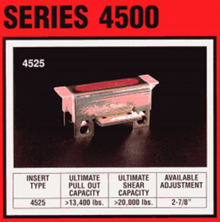
APC Wall Panel Prefabrication
AE Senior Thesis Project
Kevin Kroener │Construction Option
Wardman West Residential
Woodley Park, NW Washington, DC
Introduction
Depth 1: APC Panel Prefabrication
  Overview & Existing Wall System
  Product Selection
  Transportation & Logistics
  Cost Savings & Schedule Acceleration
  Structural Feasibility Study
Depth 2: SIPS
Depth 3: Safety Evaluation
Conclusions & Recommendations
Acknowledgements
Hardware Selection
Wind & Seismic Loading
Code:
IBC 2006 / ASCE 7-05
Assumption:
Panel Weight (12’ x 30’ @ 40 PSF) – 14,400 lb.
Wind:
Seismic:
Windward exposure
$$P = q_{h} ×\left(+GC_{p}\right)− q_{h} ×\left(−GC_{pi}\right)({lb.}/{{ft.}^{2}})$$
$$P = 18.3 ×\left(+0.62\right)− 18.3 ×\left(−0.18\right)=14.64 {lb.}/{{ft.}^{2}}$$
Leeward exposure
$$P = q_{h} ×\left(−GC_{p}\right)− q_{h} ×\left(+GC_{pi}\right)({lb.}/{{ft.}^{2}})$$
Courtesy of JVI
$$P = 18.3 ×\left(−1.1\right)− 18.3 ×\left(+0.18\right)=23.4 {lb.}/{{ft.}^{2}}$$
Working Capacity = 2,680 lb. < 2,106 lb. (Max Suction Force per attachment point)
Max Suction Force = 8,424 lb.
Horizontal Seismic Force = 850 lb. (10% of Wind Load)

Slide 21
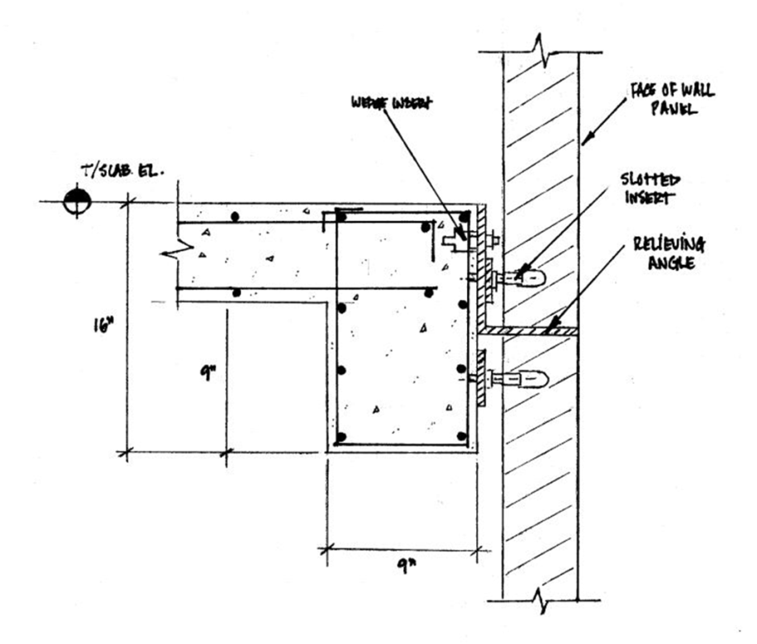
APC Wall Panel Prefabrication
AE Senior Thesis Project
Kevin Kroener │Construction Option
Wardman West Residential
Woodley Park, NW Washington, DC
Introduction
Depth 1: APC Panel Prefabrication
  Overview & Existing Wall System
  Product Selection
  Transportation & Logistics
  Cost Savings & Schedule Acceleration
  Structural Feasibility Study
Depth 2: SIPS
Depth 3: Safety Evaluation
Conclusions & Recommendations
Acknowledgements
Hardware Selection
Wind & Seismic Loading
Lateral Attachment & Spandrel Beam Redesign
Code:
IBC 2006 / ASCE 7-05
Assumption:
Panel Weight (12’ x 30’ @ 40 PSF) – 14,400 lb.
Wind:
Seismic:
Windward exposure
16’’ x 9’’ Spandrel Beam
Added Cost:
$ 54,000
$$P = q_{h} ×\left(+GC_{p}\right)− q_{h} ×\left(−GC_{pi}\right)({lb.}/{{ft.}^{2}})$$
$$P = 18.3 ×\left(+0.62\right)− 18.3 ×\left(−0.18\right)=14.64 {lb.}/{{ft.}^{2}}$$
Leeward exposure
$$P = q_{h} ×\left(−GC_{p}\right)− q_{h} ×\left(+GC_{pi}\right)({lb.}/{{ft.}^{2}})$$
Courtesy of JVI
$$P = 18.3 ×\left(−1.1\right)− 18.3 ×\left(+0.18\right)=23.4 {lb.}/{{ft.}^{2}}$$
Working Capacity = 2,680 lb. < 2,106 lb. (Max Suction Force per attachment point)
Max Suction Force = 8,424 lb.
Horizontal Seismic Force = 850 lb. (10% of Wind Load)

Slide 22
AE Senior Thesis Project
Kevin Kroener │Construction Option
Wardman West Residential
Woodley Park, NW Washington, DC
Introduction
Depth 1: APC Panel Prefabrication
Depth 2: SIPS
Depth 3: Safety Evaluation
Conclusions & Recommendations
Acknowledgements

Slide 23
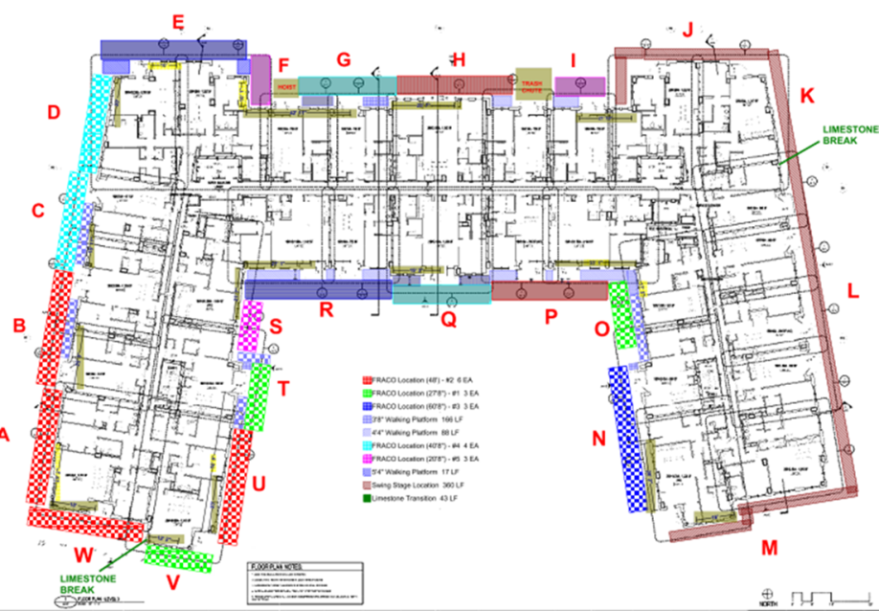
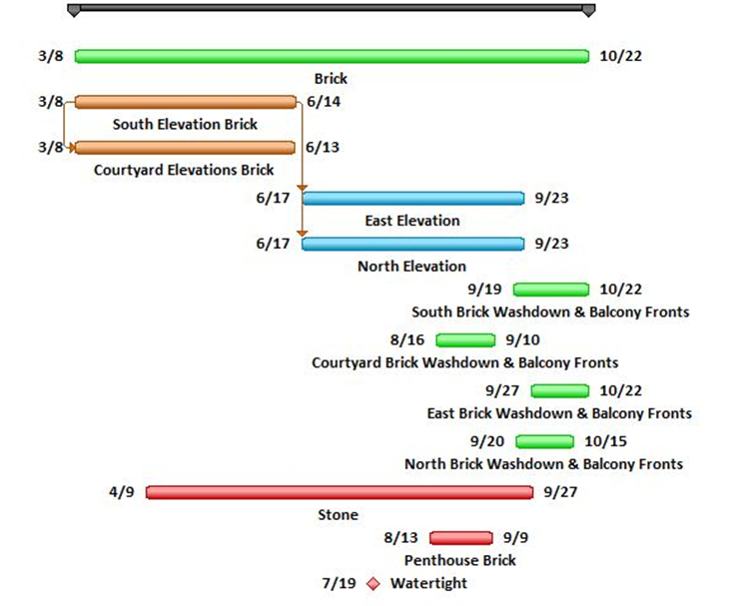
SIPS
AE Senior Thesis Project
Kevin Kroener │Construction Option
Wardman West Residential
Woodley Park, NW Washington, DC
Introduction
Depth 1: APC Panel Prefabrication
Depth 2: SIPS
  Original Schedule Analysis
  Brick SIPS
  APC Panel SIPS
Depth 3: Safety Evaluation
Conclusions & Recommendations
Acknowledgements
Original Brick Masonry Schedule
Elevation | Activity | Start | Finish | Duration
South | Brick | 8 Mar 2013 | 15 June 2013 | 71
 | Washdown & Balcony Fronts | 19 Sept 2013 | 22 Oct 2013 | 33
Court | Brick | 8 Mar 2013 | 13 June 2013 | 69
 | Washdown & Balcony Fronts | 16 Aug 2013 | 10 Sept 2013 | 25
East | Brick | 15 June 2013 | 20 Sept 2013 | 69
 | Washdown & Balcony Fronts | 27 Sept 2013 | 22 Oct 2013 | 25
North | Brick | 15 June 2013 | 20 Sept 2013 | 69
 | Washdown & Balcony Fronts | 20 Sept 2013 | 15 Oct 2013 | 25
Total |  | 8 Mar 2013 | 22 Oct 2013 | 162
Total (excluding washdown & balcony fronts) |  | 8 Mar 2013 | 27 Sept 2013 | 145
Total Brick Duration – 145 Days
Courtesy of Clark Construction
Typical Elevation Duration – 70 Days

Slide 24
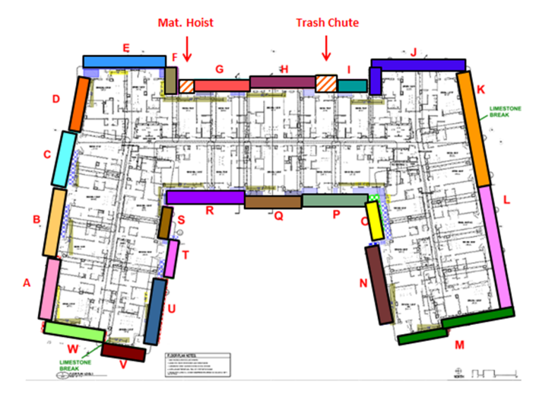
SIPS
AE Senior Thesis Project
Kevin Kroener │Construction Option
Wardman West Residential
Woodley Park, NW Washington, DC
Introduction
Depth 1: APC Panel Prefabrication
Depth 2: SIPS
  Original Schedule Analysis
  Brick SIPS
  APC Panel SIPS
Depth 3: Safety Evaluation
Conclusions & Recommendations
Acknowledgements
Brick SIPS Schedule
Floor Level | Productivity Rate (per mason)
1 | 175 brick/day
2 | 175 brick/day
3 | 175 brick/day
4 | 170 brick/day
5 | 165 brick/day
6 | 160 brick/day
7 | 155 brick/day
8 | 150 brick/day

Slide 25
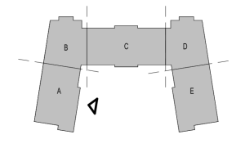
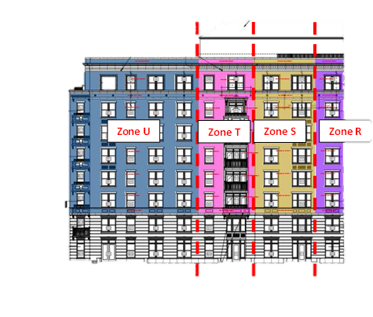
SIPS
AE Senior Thesis Project
Kevin Kroener │Construction Option
Wardman West Residential
Woodley Park, NW Washington, DC
Introduction
Depth 1: APC Panel Prefabrication
Depth 2: SIPS
  Original Schedule Analysis
  Brick SIPS
  APC Panel SIPS
Depth 3: Safety Evaluation
Conclusions & Recommendations
Acknowledgements
Brick SIPS Schedule
Floor Level | Productivity Rate (per mason)
1 | 175 brick/day
2 | 175 brick/day
3 | 175 brick/day
4 | 170 brick/day
5 | 165 brick/day
6 | 160 brick/day
7 | 155 brick/day
8 | 150 brick/day
Sample Calculation:
4th Floor – Zone E (East Elevation)
Total Area – 375 S.F.
375 S.F. × (6.55 brick)/(S.F.) = 2,457 brick
2,457 ÷ (170 (brick )/(per mason) × 3 masons) × 1.25 (6 hrs. of labor) = 6 days

Slide 26
SIPS
AE Senior Thesis Project
Kevin Kroener │Construction Option
Wardman West Residential
Woodley Park, NW Washington, DC
Introduction
Depth 1: APC Panel Prefabrication
Depth 2: SIPS
  Original Schedule Analysis
  Brick SIPS
  APC Panel SIPS
Depth 3: Safety Evaluation
Conclusions & Recommendations
Acknowledgements
Brick SIPS Schedule
Floor Level | Productivity Rate (per mason)
1 | 175 brick/day
2 | 175 brick/day
3 | 175 brick/day
4 | 170 brick/day
5 | 165 brick/day
6 | 160 brick/day
7 | 155 brick/day
8 | 150 brick/day
Sample Calculation:
4th Floor – Zone E (East Elevation)
Total Area – 375 S.F.
375 S.F. × (6.55 brick)/(S.F.) = 2,457 brick
2,457 ÷ (170 (brick )/(per mason) × 3 masons) × 1.25 (6 hrs. of labor) = 6 days

Slide 27
SIPS
AE Senior Thesis Project
Kevin Kroener │Construction Option
Wardman West Residential
Woodley Park, NW Washington, DC
Introduction
Depth 1: APC Panel Prefabrication
Depth 2: SIPS
  Original Schedule Analysis
  Brick SIPS
  APC Panel SIPS
Depth 3: Safety Evaluation
Conclusions & Recommendations
Acknowledgements
Brick SIPS Schedule
Total Brick SIPS Duration - 133 Days
Schedule Acceleration - 12 Days
Floor Level | Productivity Rate (per mason)
1 | 175 brick/day
2 | 175 brick/day
3 | 175 brick/day
4 | 170 brick/day
5 | 165 brick/day
6 | 160 brick/day
7 | 155 brick/day
8 | 150 brick/day
Sample Calculation:
4th Floor – Zone E (East Elevation)
Total Area – 375 S.F.
375 S.F. × (6.55 brick)/(S.F.) = 2,457 brick
2,457 ÷ (170 (brick )/(per mason) × 3 masons) × 1.25 (6 hrs. of labor) = 6 days

Slide 28
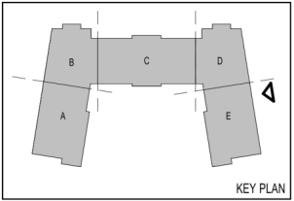
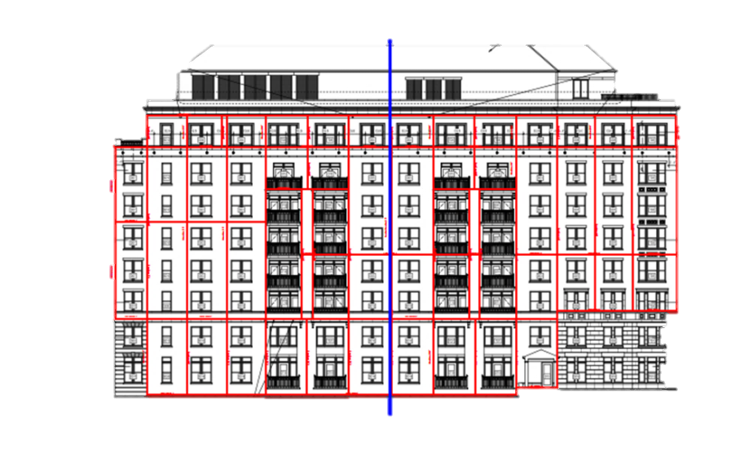
SIPS
AE Senior Thesis Project
Kevin Kroener │Construction Option
Wardman West Residential
Woodley Park, NW Washington, DC
Introduction
Depth 1: APC Panel Prefabrication
Depth 2: SIPS
  Original Schedule Analysis
  Brick SIPS
  APC Panel SIPS
Depth 3: Safety Evaluation
Conclusions & Recommendations
Acknowledgements
APC Wall Panel SIPS Schedule
Construction Zone | Elevation | # of Panels | Crane | Duration (Days)
A1 | East | 22 | Mobile | 4
A2 | East | 26 | Mobile | 5
A3 | East | 22 | Mobile | 4
B | North | 38 | Mobile | 7
C | Northwest | 21 | Mobile | 4
D | South Courtyard | 29 | Tower | 5
E | West Courtyard | 34 | Tower | 6
F | North Courtyard | 26 | Tower | 5
G1 | South | 26 | Tower | 5
G2 | South | 25 | Tower | 5
H | Southwest | 21 | Tower | 4
Total |  | 290 |  | 54
Zone G1
Zone G2
Average # of Panels per Zone - 27
Panel Erection Productivity Rate – 6 panels/day

Slide 29
SIPS
AE Senior Thesis Project
Kevin Kroener │Construction Option
Wardman West Residential
Woodley Park, NW Washington, DC
Introduction
Depth 1: APC Panel Prefabrication
Depth 2: SIPS
  Original Schedule Analysis
  Brick SIPS
  APC Panel SIPS
Depth 3: Safety Evaluation
Conclusions & Recommendations
Acknowledgements
APC Wall Panel SIPS Schedule
Construction Zone | Elevation | # of Panels | Crane | Duration (Days)
A1 | East | 22 | Mobile | 4
A2 | East | 26 | Mobile | 5
A3 | East | 22 | Mobile | 4
B | North | 38 | Mobile | 7
C | Northwest | 21 | Mobile | 4
D | South Courtyard | 29 | Tower | 5
E | West Courtyard | 34 | Tower | 6
F | North Courtyard | 26 | Tower | 5
G1 | South | 26 | Tower | 5
G2 | South | 25 | Tower | 5
H | Southwest | 21 | Tower | 4
Total |  | 290 |  | 54
Total APC Wall Panel SIPS Duration - 54 Days
Schedule Acceleration - 3 Days
Zone G1
Zone G2
Average # of Panels per Zone - 27
Panel Erection Productivity Rate – 6 panels/day

Slide 30
AE Senior Thesis Project
Kevin Kroener │Construction Option
Safety Evaluation
Wardman West Residential
Woodley Park, NW Washington, DC
Introduction
Depth 1: APC Panel Prefabrication
Depth 2: SIPS
Depth 3: Safety Evaluation
  Scoring System Comparison
Conclusions & Recommendations
Acknowledgements
Scoring Criteria:
Scoring Value | Level of Concern
1 | Safety Category is considered fairly safe with a low level of safety concern involved.
2 | Safety Category is considered somewhat hazardous with a moderate level of safety concern involved.
3 | Safety Category is considered very dangerous with a high level of safety concern involved.
Safety Category | Precast Wall Panel Erection & Installation | Brick Masonry Installation
Fall Protection | 3 | 3
Equipment Inspection | 2 | 3
Safety Training | 2 | 1
Hazardous Materials | 2 | 2
Incidents/Injuries | 3 | 2
Total Score | 12 | 11

Slide 31
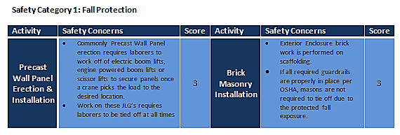
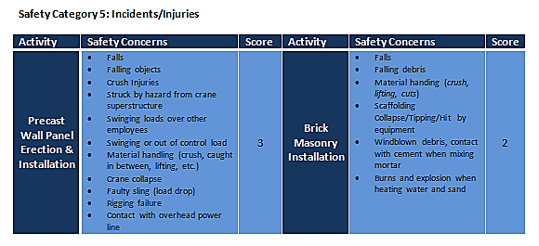
AE Senior Thesis Project
Kevin Kroener │Construction Option
Safety Evaluation
Wardman West Residential
Woodley Park, NW Washington, DC
Introduction
Depth 1: APC Panel Prefabrication
Depth 2: SIPS
Depth 3: Safety Evaluation
  Scoring System Comparison
Conclusions & Recommendations
Acknowledgements
Scoring Criteria:
Scoring Value | Level of Concern
1 | Safety Category is considered fairly safe with a low level of safety concern involved.
2 | Safety Category is considered somewhat hazardous with a moderate level of safety concern involved.
3 | Safety Category is considered very dangerous with a high level of safety concern involved.
Safety Category | Precast Wall Panel Erection & Installation | Brick Masonry Installation
Fall Protection | 3 | 3
Equipment Inspection | 2 | 3
Safety Training | 2 | 1
Hazardous Materials | 2 | 2
Incidents/Injuries | 3 | 2
Total Score | 12 | 11

Slide 32
AE Senior Thesis Project
Kevin Kroener │Construction Option
Safety Evaluation
Wardman West Residential
Woodley Park, NW Washington, DC
Introduction
Depth 1: APC Panel Prefabrication
Depth 2: SIPS
Depth 3: Safety Evaluation
  Scoring System Comparison
Conclusions & Recommendations
Acknowledgements
Scoring Criteria:
Scoring Value | Level of Concern
1 | Safety Category is considered fairly safe with a low level of safety concern involved.
2 | Safety Category is considered somewhat hazardous with a moderate level of safety concern involved.
3 | Safety Category is considered very dangerous with a high level of safety concern involved.
Safety Category | Precast Wall Panel Erection & Installation | Brick Masonry Installation
Fall Protection | 3 | 3
Equipment Inspection | 2 | 3
Safety Training | 2 | 1
Hazardous Materials | 2 | 2
Incidents/Injuries | 3 | 2
Total Score | 12 | 11
Activity Hazard Analysis:
Principle Steps
Potential Hazards
Recommended Controls
Required Equipment
Inspection Requirements
Training Requirements

Slide 33
AE Senior Thesis Project
Kevin Kroener │Construction Option
Conclusions & Recommendations
Wardman West Residential
Woodley Park, NW Washington, DC
Introduction
Depth 1: APC Panel Prefabrication
Depth 2: SIPS
Depth 3: Safety Evaluation
Conclusions & Recommendations
Acknowledgements
  Analysis 1: Architectural Precast Concrete Wall Panels
  Accelerated Schedule – 46 Days
  Saved $ 646,000
  Improved Quality
  Structurally Feasible

Slide 34
AE Senior Thesis Project
Kevin Kroener │Construction Option
Conclusions & Recommendations
Wardman West Residential
Woodley Park, NW Washington, DC
Introduction
Depth 1: APC Panel Prefabrication
Depth 2: SIPS
Depth 3: Safety Evaluation
Conclusions & Recommendations
Acknowledgements
  Analysis 1: Architectural Precast Concrete Wall Panels
  Accelerated Schedule – 46 Days
  Saved $ 646,000
  Improved Quality
  Structurally Feasible
      Analysis 2: SIPS (Short Interval Production Schedule)
      Accelerated Schedule
        Brick – 12 Days
        APC Wall Panels – 3 Days
      Improved Productivity

Slide 35
AE Senior Thesis Project
Kevin Kroener │Construction Option
Conclusions & Recommendations
Wardman West Residential
Woodley Park, NW Washington, DC
Introduction
Depth 1: APC Panel Prefabrication
Depth 2: SIPS
Depth 3: Safety Evaluation
Conclusions & Recommendations
Acknowledgements
  Analysis 1: Architectural Precast Concrete Wall Panels
  Accelerated Schedule – 46 Days
  Saved $ 646,000
  Improved Quality
  Structurally Feasible
      Analysis 2: SIPS (Short Interval Production Schedule)
      Accelerated Schedule
        Brick – 12 Days
        APC Wall Panels – 3 Days
      Improved Productivity
          Analysis 3: Safety Evaluation
          Identified Safety Concerns
          Improved Site Safety w/ AHA

Slide 36







AE Senior Thesis Project
Kevin Kroener │Construction Option
Acknowledgements
Wardman West Residential
Woodley Park, NW Washington, DC
Introduction
Depth 1: APC Panel Prefabrication
Depth 2: SIPS
Depth 3: Safety Evaluation
Conclusions & Recommendations
Acknowledgements
Academic Acknowledgments
Industry Acknowledgements
Special Thanks
Abe Vogel - Clark Construction Group, LLC
Sara Hand - Clark Construction Group, LLC
Wardman West Residential Project Team
John O’Keefe – Atkinson Construction
Matt Quigg – Gate Precast Company
Ed Kroener – WorleyParsons
Julia Gamble
My Family and Friends
Ray Sowers – Faculty Advisor &
The Architectural Engineering Department

Slide 37
Wardman West Residential
AE Senior Thesis Project
Kevin Kroener │Construction Option
Wardman West Residential
Woodley Park, NW Washington, DC
Introduction
Depth 1: APC Panel Prefabrication
Depth 2: SIPS
Depth 3: Safety Evaluation
Conclusions & Recommendations
Acknowledgements
Questions?

Slide 38
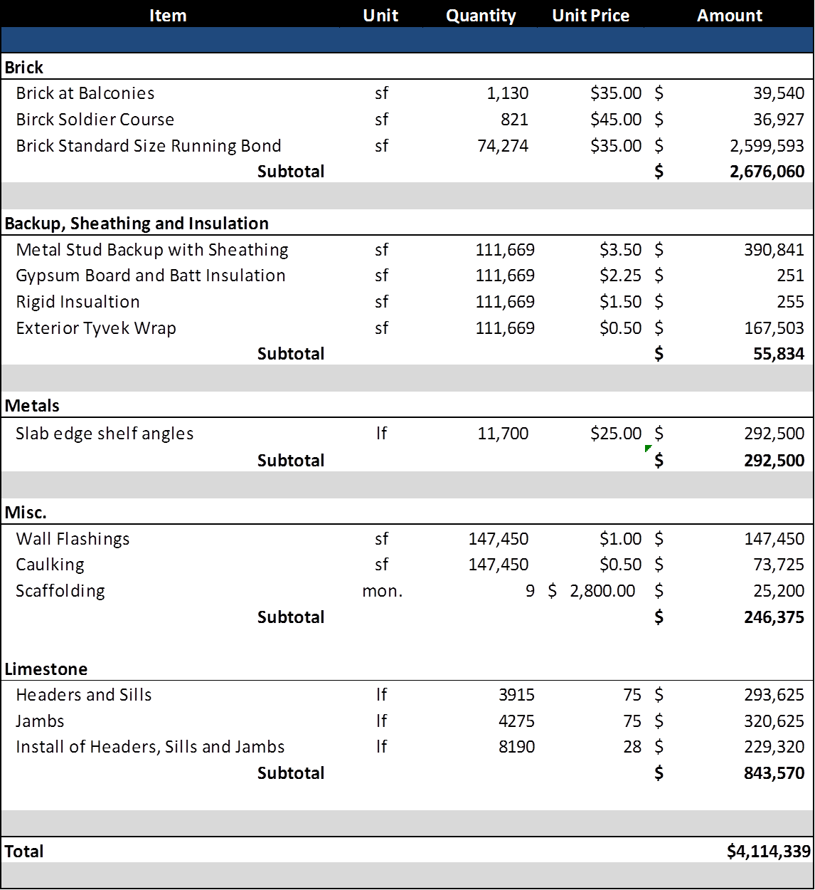
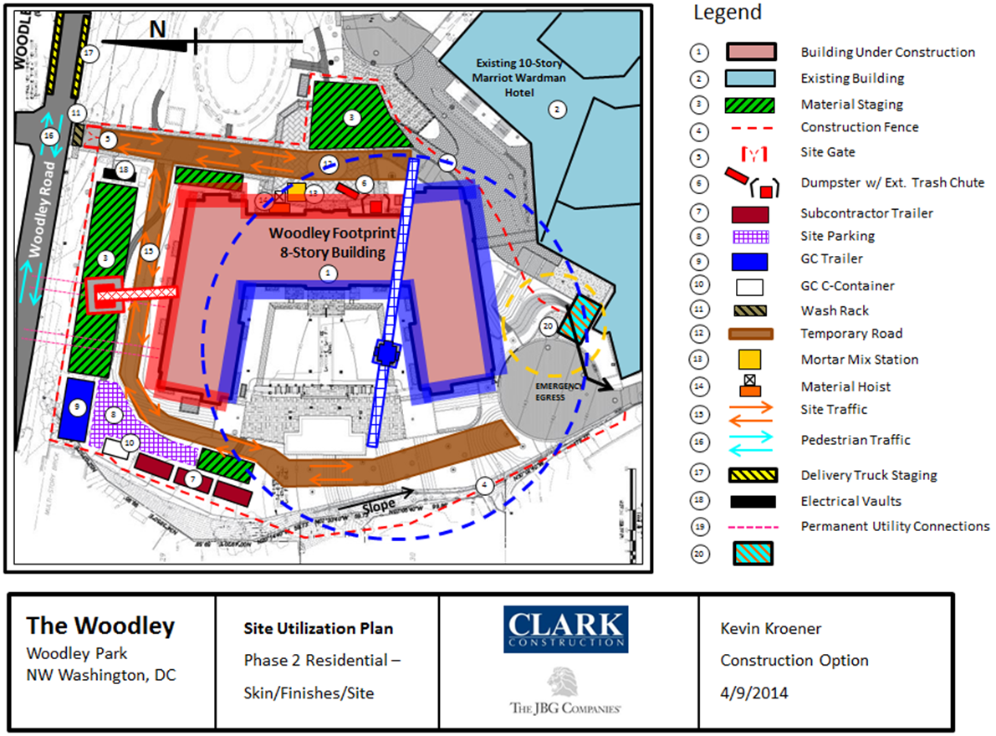
AE Senior Thesis Project
Kevin Kroener │Construction Option
Wardman West Residential
Woodley Park, NW Washington, DC
Introduction
Depth 1: APC Panel Prefabrication
Depth 2: SIPS
Depth 3: Safety Evaluation
Conclusions & Recommendations
Acknowledgements

Slide 39
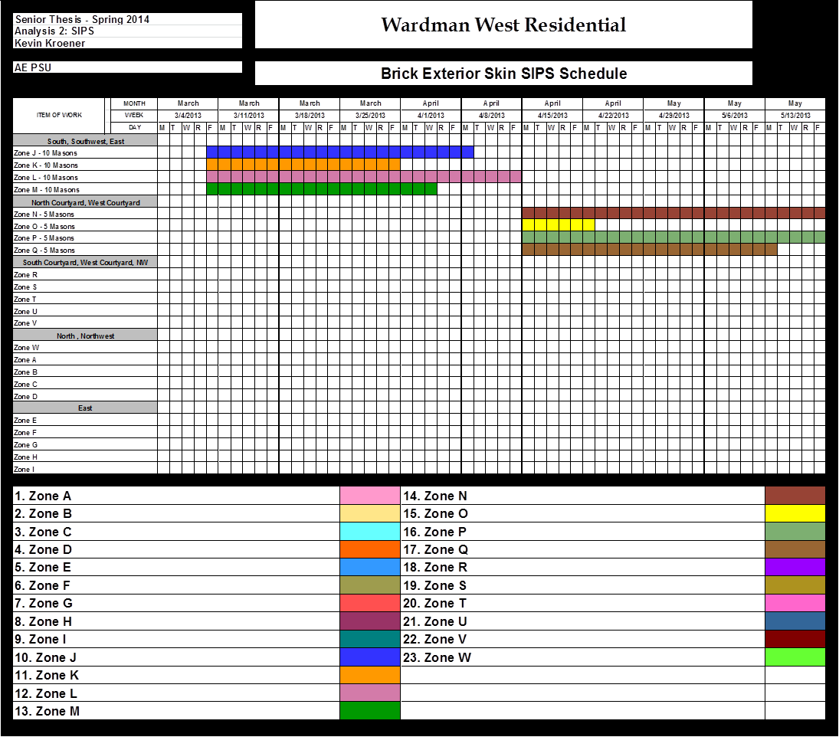
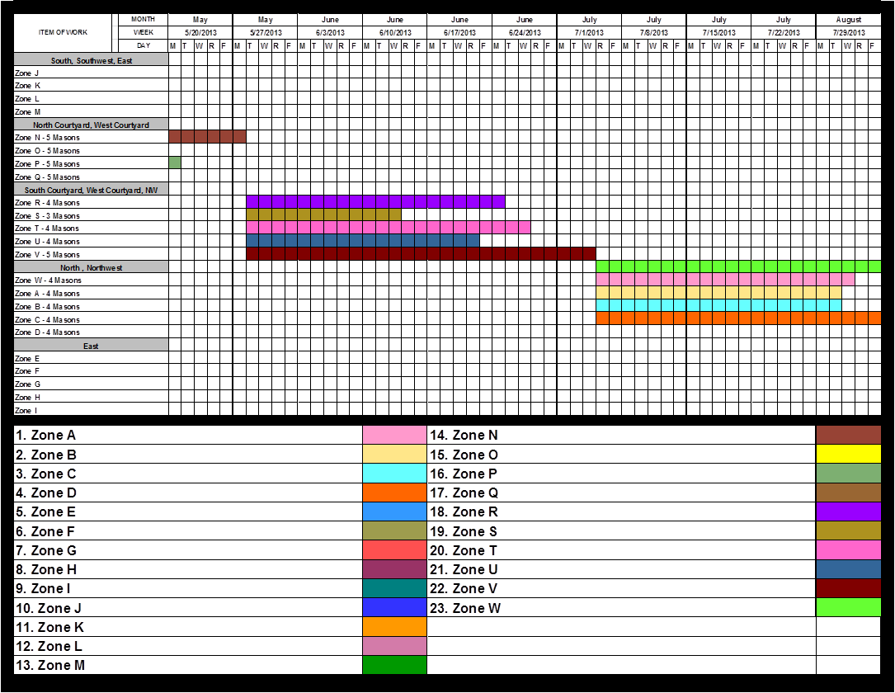
AE Senior Thesis Project
Kevin Kroener │Construction Option
Wardman West Residential
Woodley Park, NW Washington, DC
Introduction
Depth 1: APC Panel Prefabrication
Depth 2: SIPS
Depth 3: Safety Evaluation
Conclusions & Recommendations
Acknowledgements

Slide 40
AE Senior Thesis Project
Kevin Kroener │Construction Option
Wardman West Residential
Woodley Park, NW Washington, DC
Introduction
Depth 1: APC Panel Prefabrication
Depth 2: SIPS
Depth 3: Safety Evaluation
Conclusions & Recommendations
Acknowledgements

Slide 41
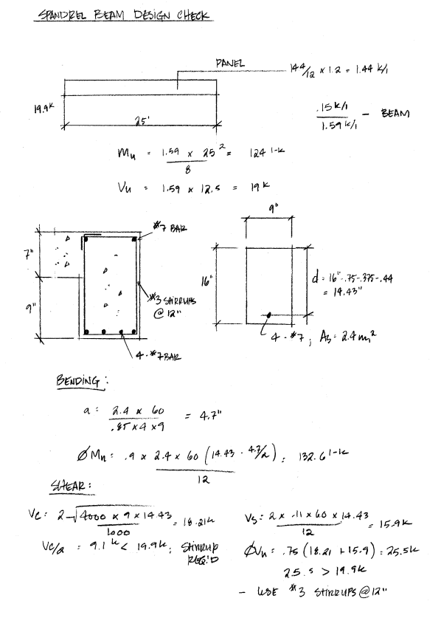

AE Senior Thesis Project
Kevin Kroener │Construction Option
Wardman West Residential
Woodley Park, NW Washington, DC
Introduction
Depth 1: APC Panel Prefabrication
Depth 2: SIPS
Depth 3: Safety Evaluation
Conclusions & Recommendations
Acknowledgements

